Slide 1
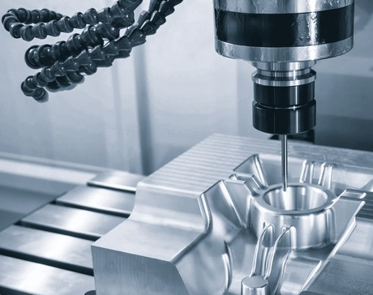


CAM PROGRAMMING
MUHAMMAD KEVIN FAHLEVI
NEPTUN CODE: QFR5R2

Slide 2
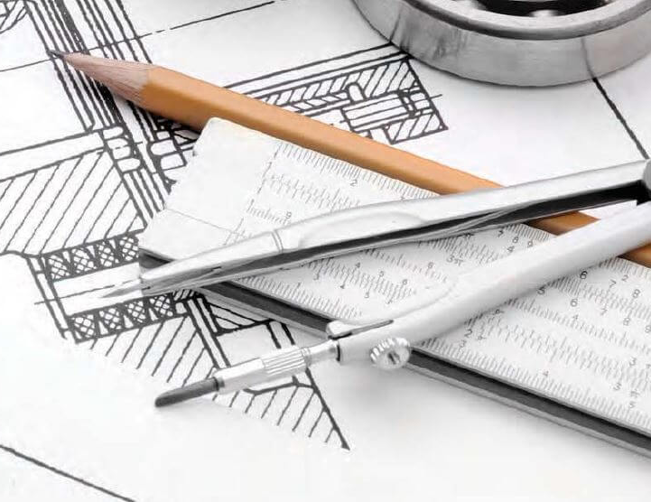
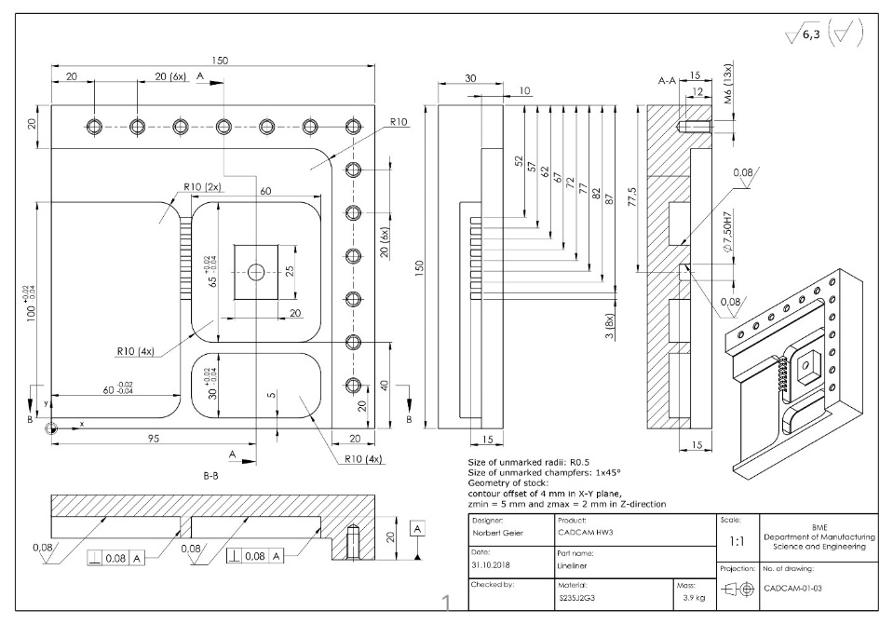
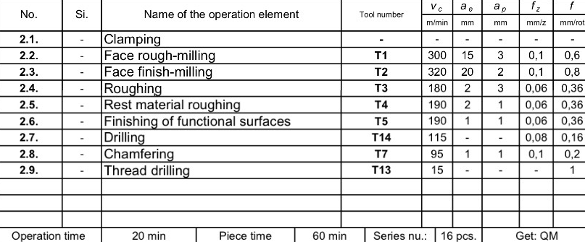
Assigned CAD Drawing
Technical Drawing - CAD
Operation Element - CAM

Slide 3
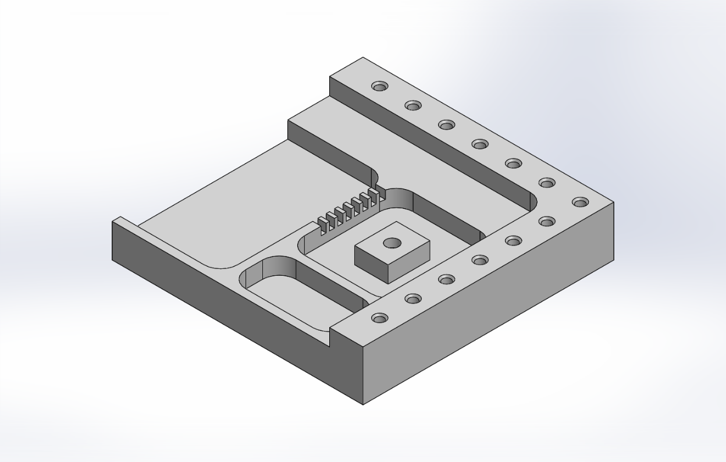
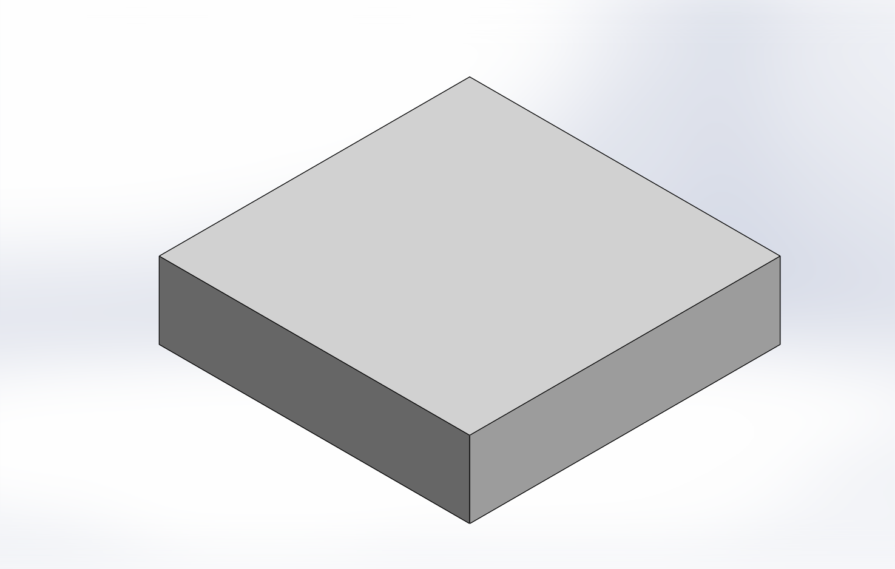
Designed CAD Model
Part Model
Stock Model
Name: Lineliner
Material: S235J2G3 – Carbon steel plate
Mass: 3.9 Kg

Slide 4
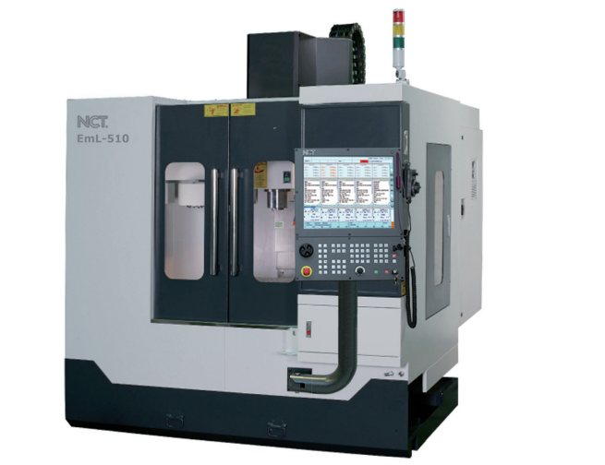
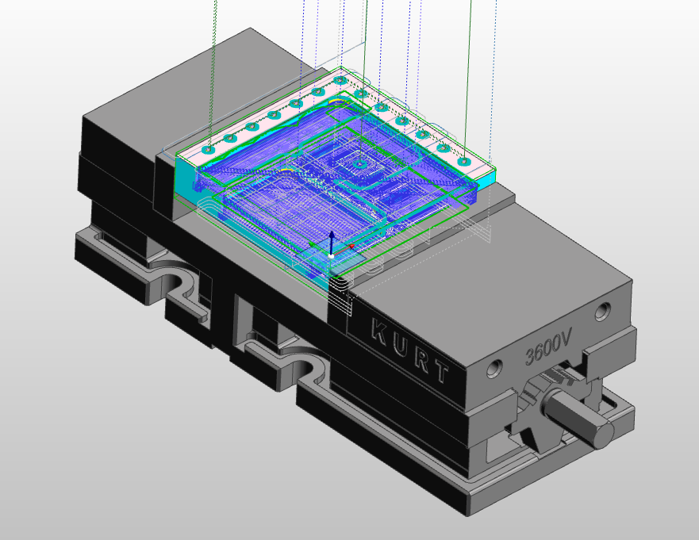
Manufacturing Data
About the manufacturing cycles…
Total operation: 9
Total sequence: 34
Total time: 35 min 29 sec
About the machine…
Machine: NCT/Eml-510
Table size: 600 x 320 mm
Table load capacity: 300 kg
X-axis travel: 510 mm
Y-axis travel: 410 mm
Z-axis travel: 460 mm
Spindle speed: Standard up to 8,000 RPM; optional up to 12,000 RPM
About the clamping…
Chosen clamping: KURT 3600

Slide 5
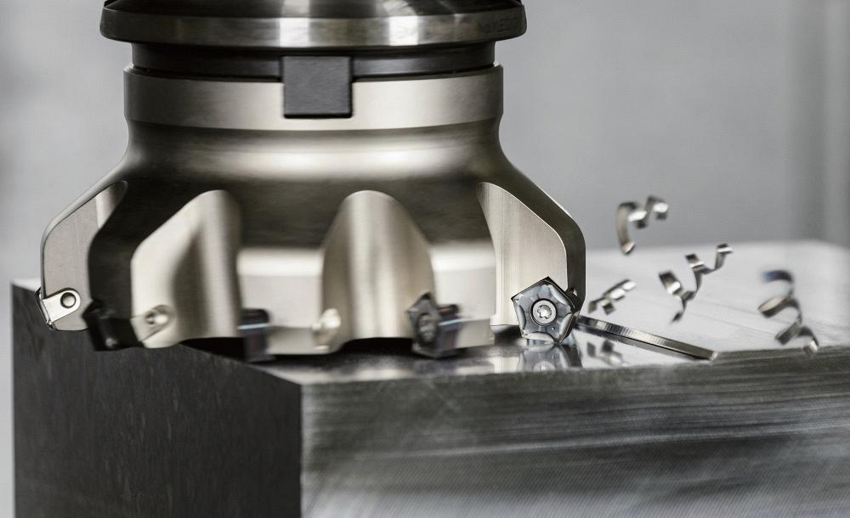
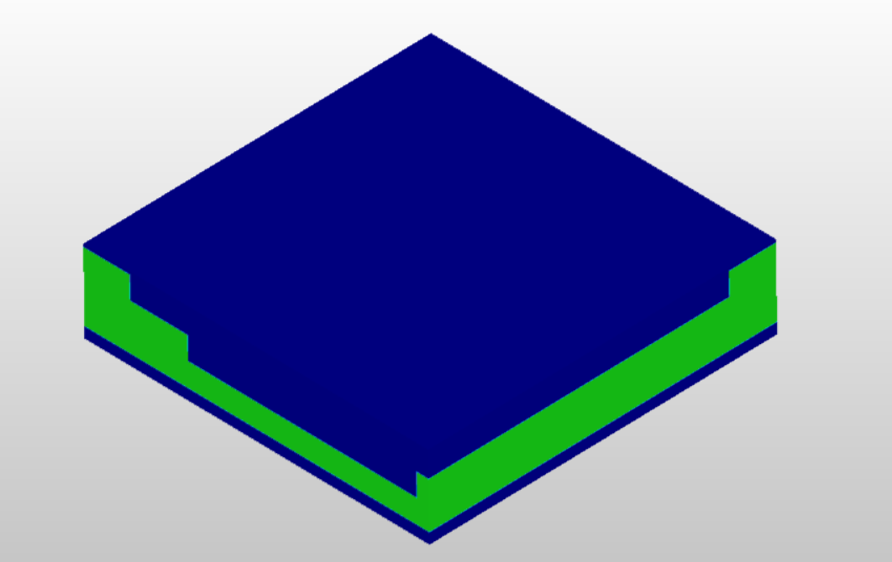
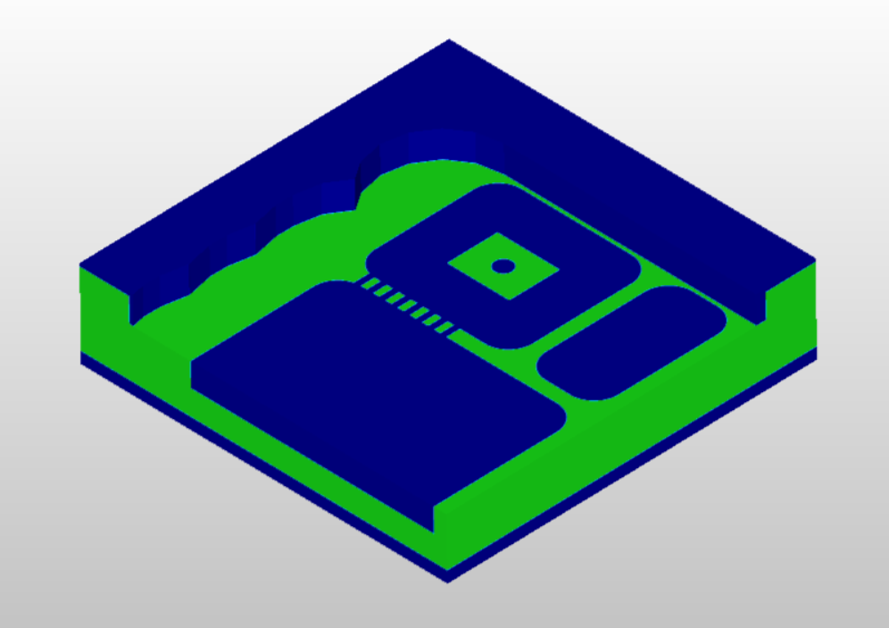
Tool reasoning: To efficiently and accurately remove material while leaving a 0.5 mm layer for the finishing process
Manufacturing Processes
1
1. Face-Rough Milling
Given parameters:
T1 = 50.0 MM DIA X 90 DEGREE FACE MILL
V_{c} = 300 [m/min]
a_{e} = 15 [mm]
a_{p} = 3 [mm]
f_{z} = 0.1 [mm/z]
f = 0.6 [mm/rot]
Calculated parameters:
n = 1909.85 [rpm]
Stepover = 30 [%]
Manufacturing time = 00:06:02 [h:min:s]
2

Slide 6
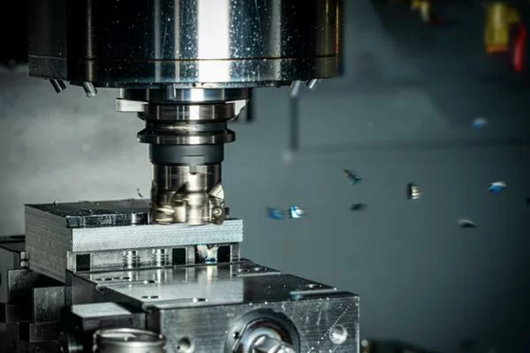
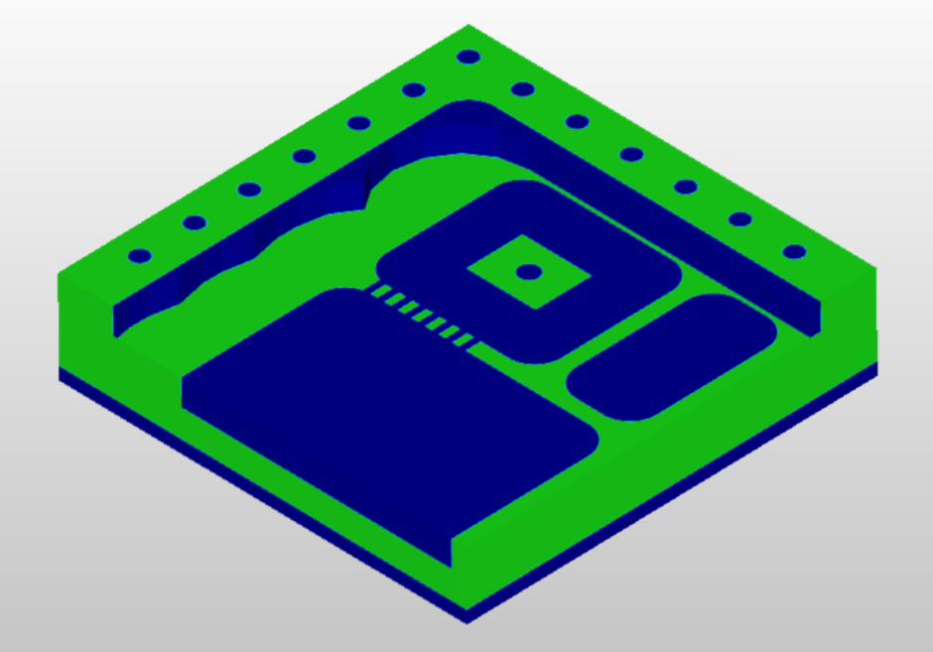
Tool reasoning: Complete the work initiated by T1, ensuring a smooth surface finish
Manufacturing Processes
2. Face-Finish Milling
Given parameters:
T2 = 60.0 MM DIA X 90 DEGREE FACE MI LL
V_{c} = 320 [m/min]
a_{e} = 20 [mm]
a_{p} = 2 [mm]
f_{z} = 0.1 [mm/z]
f = 0.8 [mm/rot]
Calculated parameters:
n = 1697.65 [rpm]
Stepover = 33.33 [%]
Manufacturing time = 00:01:05 [h:min:s]

Slide 7
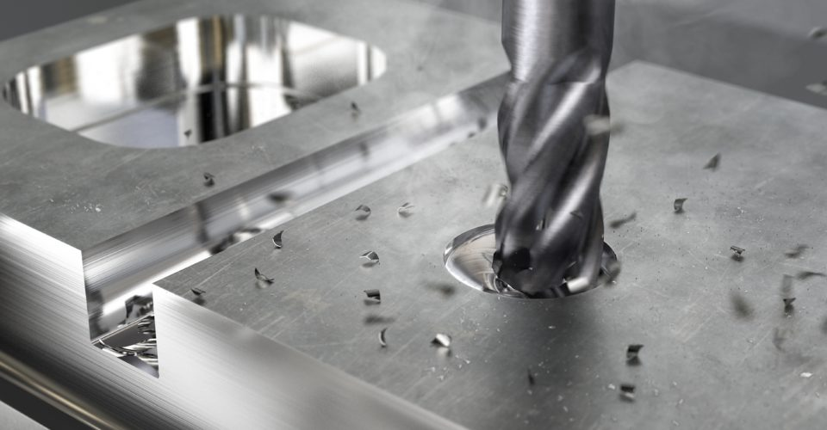
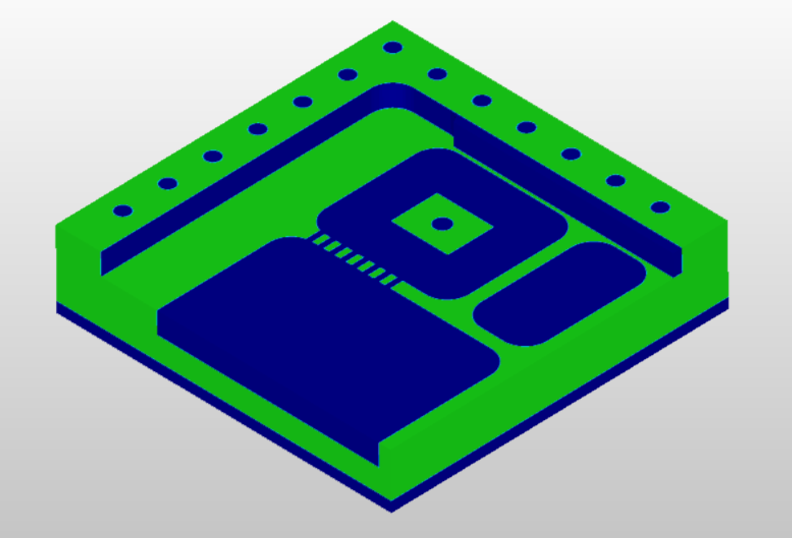
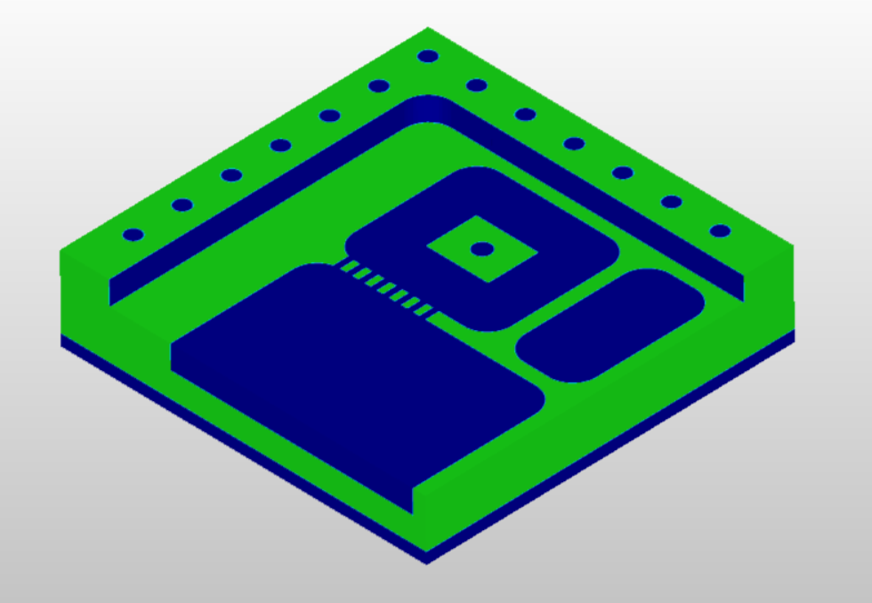
Tool reasoning: Its diameter is optimally sized to enable a fast and efficient roughing cycle
Manufacturing Processes
1
3. Roughing
Given parameters:
T3 = 10.0 MM DIA MULTI-FLUTE END MILL
V_{c} = 180 [m/min]
a_{e} = 2 [mm]
a_{p} = 3 [mm]
f_{z} = 0.06 [mm/z]
f = 0.36 [mm/rot]
Calculated parameters:
n = 5729.58 [rpm]
Stepover = 20 [%]
Manufacturing time = 00:09:04 [h:min:s]
2
3

Slide 8
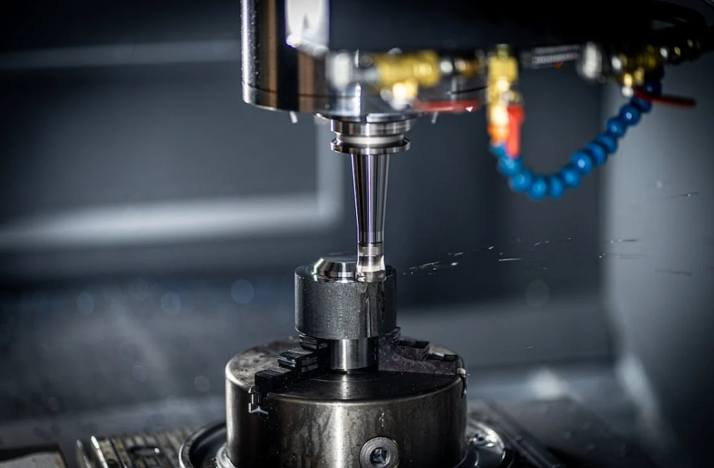
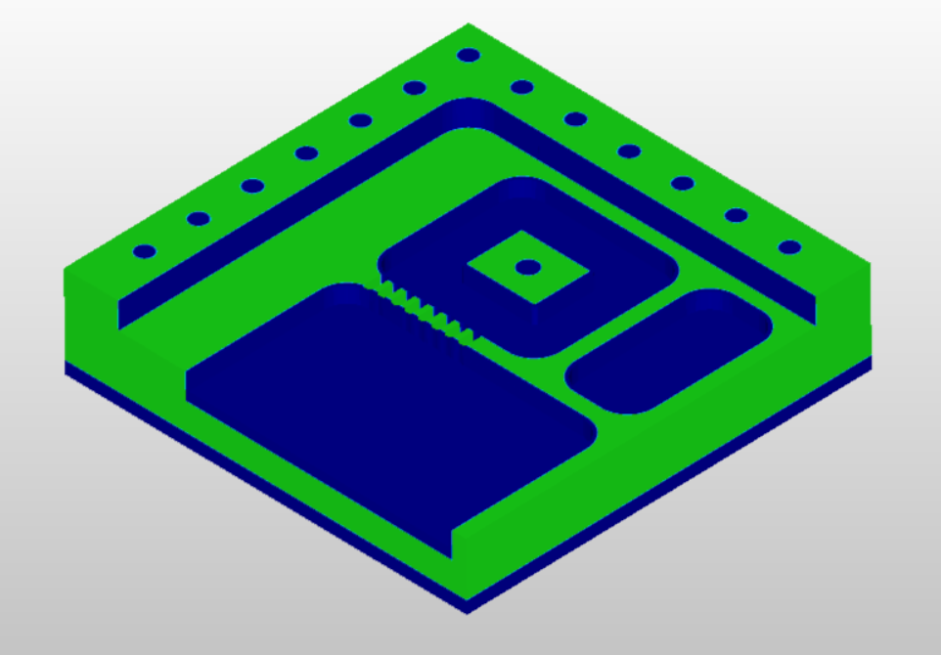
Tool reasoning: This step prepares the surface for finishing, and using a smaller tool helps minimize stress and potential damage
Manufacturing Processes
4. Rest Material Roughing
Given parameters:
T4 = 2.0 MM DIA X 0.5 MM RAD ENDMILL
V_{c} = 190 [m/min]
a_{e} = 2 [mm]
a_{p} = 1 [mm]
f_{z} = 0.06 [mm/z]
f = 0.36 [mm/rot]
Calculated parameters:
n = 10000 [rpm]
Stepover = 100 [%]
Manufacturing time = 00:00:49 [h:min:s]

Slide 9
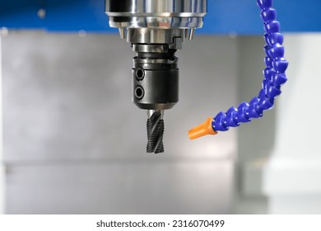
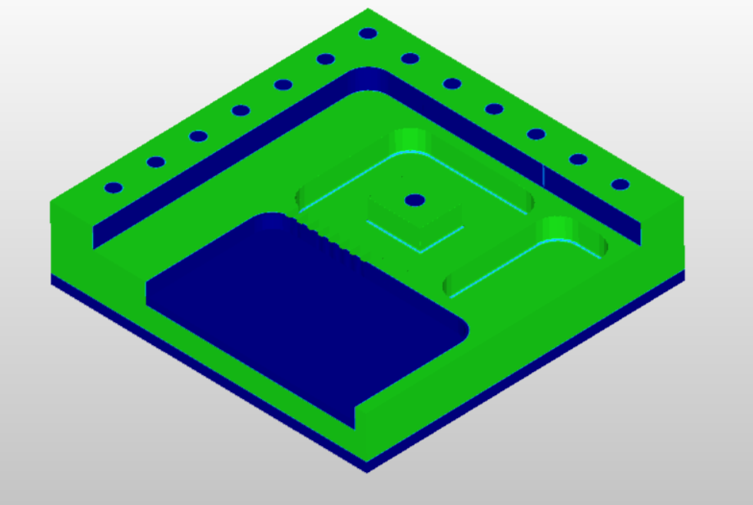
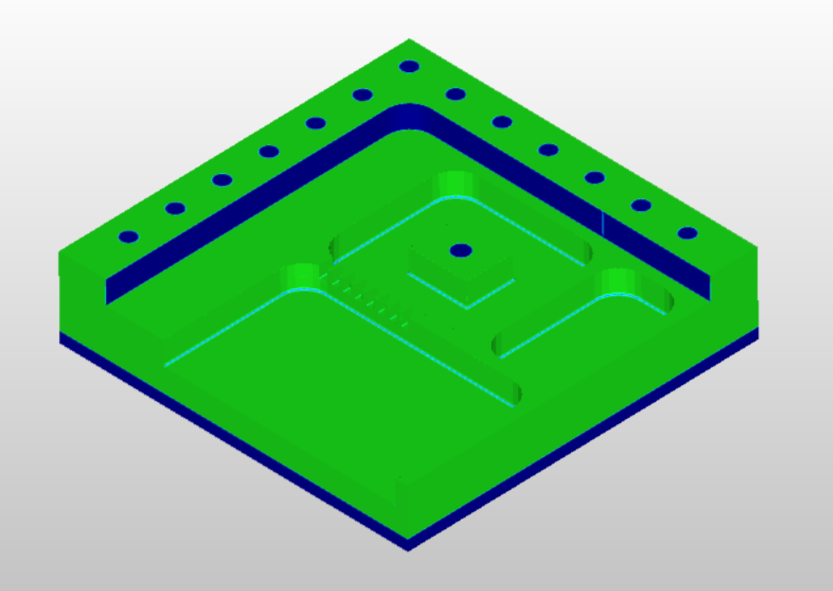
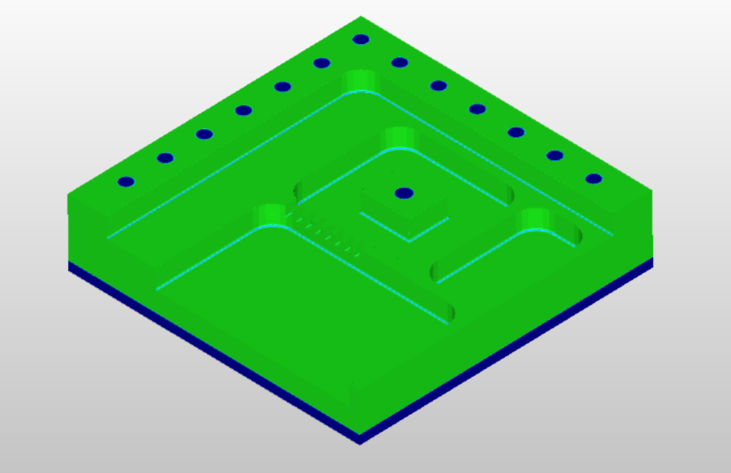
Tool reasoning: Climb mills and finishes
Manufacturing Processes
1
5. Finishing of Functional Surfaces
Given parameters:
T5 = 10 MM DIA X 1 MM RAD END MILL
V_{c} = 190 [m/min]
a_{e} = 1 [mm]
a_{p} = 1 [mm]
f_{z} = 0.06 [mm/z]
f = 0.36 [mm/rot]
Calculated parameters:
n = 6047.89 [rpm]
Stepover = - [%]
Manufacturing time = 00:15:09 [h:min:s]
2
3

Slide 10
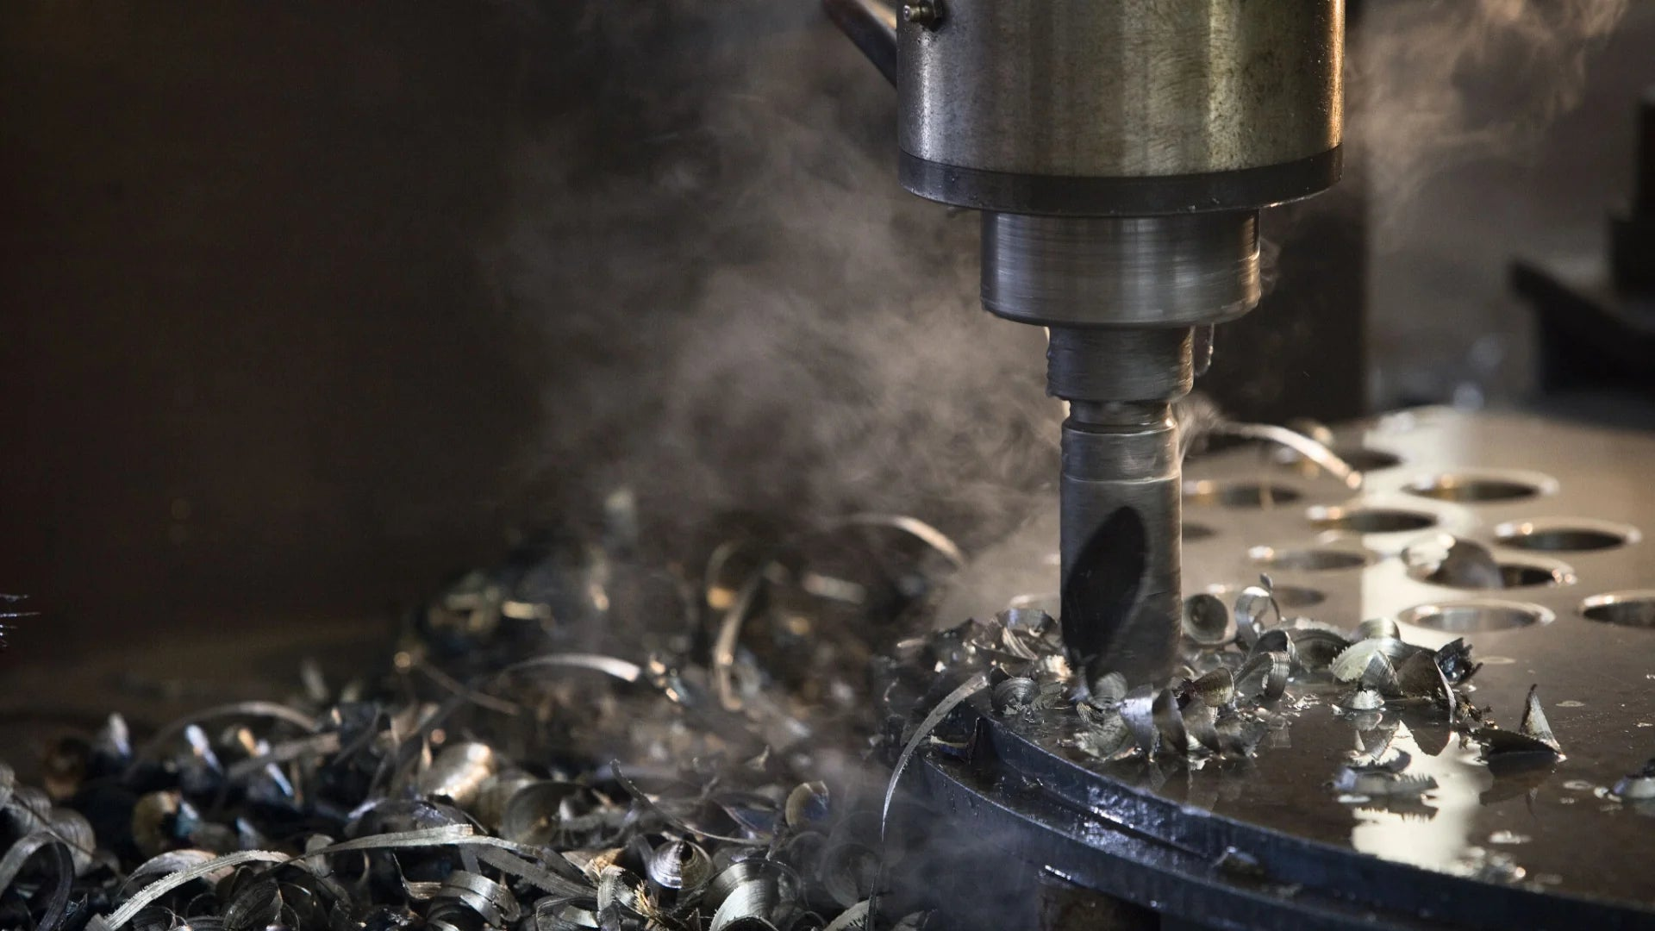
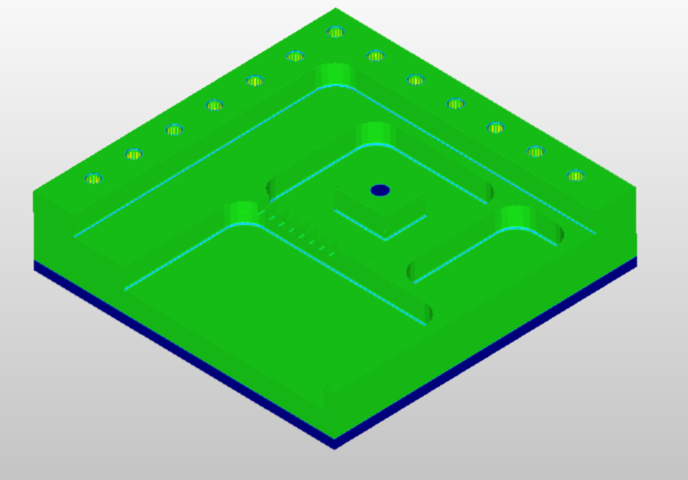
Tool reasoning: According to the standard M6 thread
Manufacturing Processes
6. Drilling
Given parameters:
T14 = 6 MM DIA DRILL
V_{c} = 115 [m/min]
a_{e} = - [mm]
a_{p} = - [mm]
f_{z} = 0.08 [mm/z]
f = 0.16 [mm/rot]
Calculated parameters:
n = 6100.94 [rpm]
Stepover = - [%]
Manufacturing time = 00:00:35 [h:min:s]

Slide 11
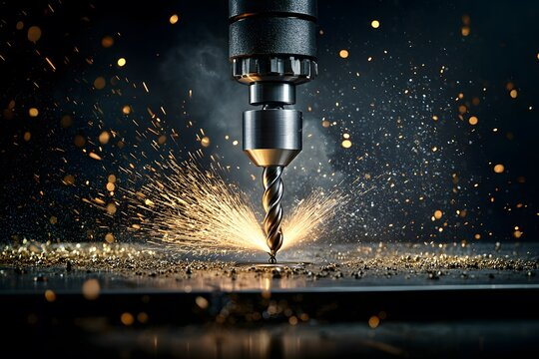
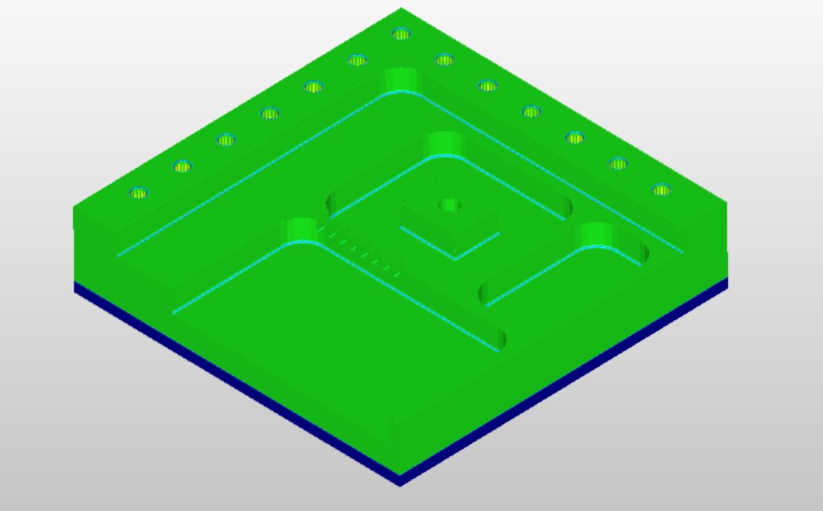
Tool reasoning: To create a 7,5H7 hole
Manufacturing Processes
7. Simple Drilling
Given parameters:
T15 = 7.5 MM DIA MACHINE REAMER
V_{c} = 115 [m/min]
a_{e} = - [mm]
a_{p} = - [mm]
f_{z} = 0.08 [mm/z]
f = 0.16 [mm/rot]
Calculated parameters:
n = 4880.75 [rpm]
Stepover = - [%]
Manufacturing time = 00:00:01 [h:min:s]

Slide 12
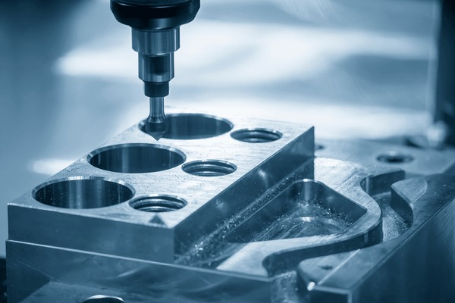
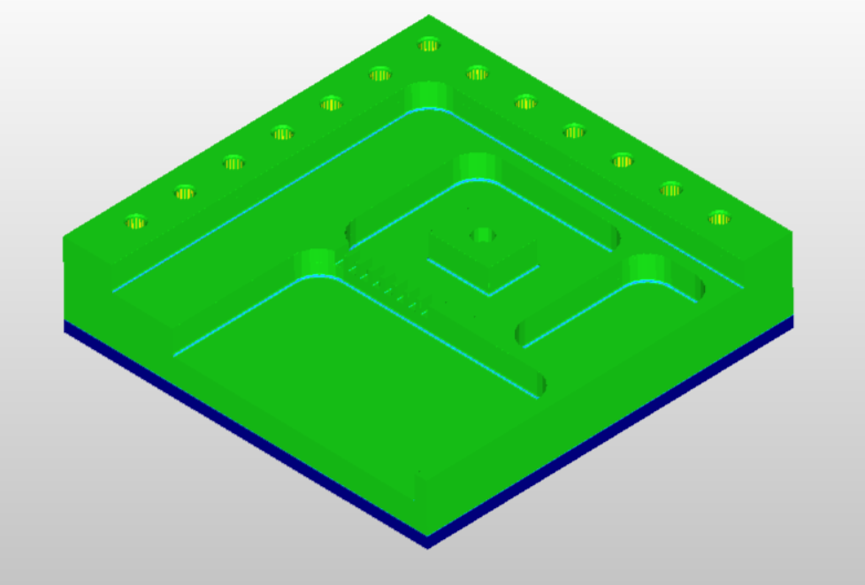
Tool reasoning: Chamfer tool, reduces the stress on the edges
Manufacturing Processes
8. Chamfering
Given parameters:
T7 = 15.0 MM DIA X 90 COUNTERSINK
- 3.0 MM MIN DIA
V_{c} = 95 [m/min]
a_{e} = 1 [mm]
a_{p} = 1 [mm]
f_{z} = 0.1 [mm/z]
f = 0.2 [mm/rot]
Calculated parameters:
n = 2015.96 [rpm]
Stepover = - [%]
Manufacturing time = 00:01:06 [h:min:s]

Slide 13
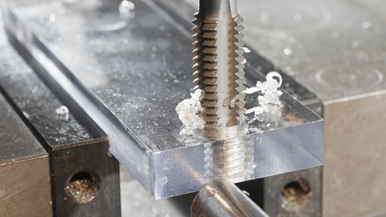
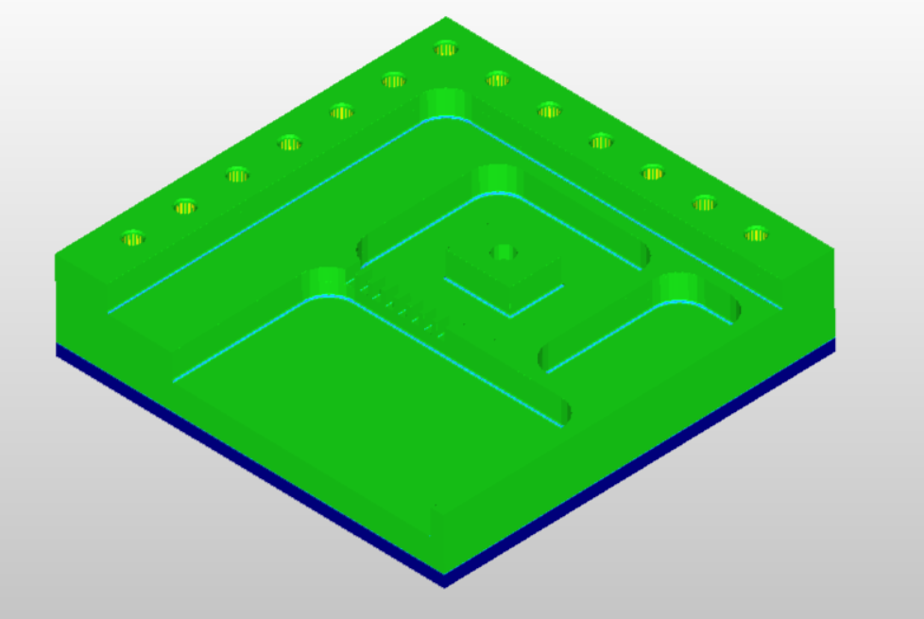
Tool reasoning: Specified by the standard for creating an M6 threaded hole
Manufacturing Processes
9. Thread Drilling
Given parameters:
T13 = M6 X 1.0 RH SPIRAL FLUTE TAP
V_{c} = 15 [m/min]
a_{e} = - [mm]
a_{p} = - [mm]
f_{z} = - [mm/z]
f = 1 [mm/rot]
Calculated parameters:
n = 795.77 [rpm]
Stepover = - [%]
Manufacturing time = 00:00:35 [h:min:s]

Slide 14
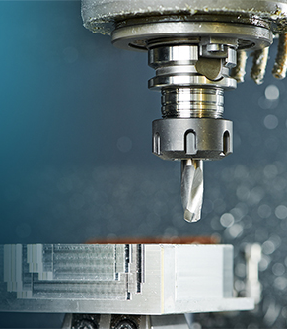
Thank you!

